Slide 1

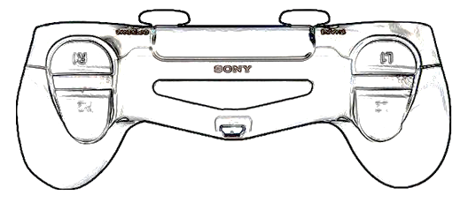
Driver’s Controller
Extend Hatch Pistons
Retract Hatch Pistons
Drive
Forward /
Reverse
Skid Steer
Left / Right

Slide 2
Operator’s Controller
R1: Intake Cargo
L1: Eject Cargo
Rotate
Hand
Lift / Lower
Arm

